Slide 1
FIN
“Your mobile device has quickly become the easiest portal into your digital self.”
A Friend In Need

Slide 2
TEAM MEMBERS
MD Zahidul Haque 180204136
Sanjida Aziz Tonny 180204122
S M Tasnimul Hasan 180204142
Fazle Elahi Safin 180204119
K H Rifat Amin 180204116

Slide 3

What is FIN ?
FIN is an emergency service based android application.

Slide 4
Purpose Behind Information Gathering & Survey
To make our App more realistic and user friendly
To add more important & realistic features
Understanding consumer’s need
To understand current market situation
Make it accessible to more people

Slide 5
Survey Analysis

Slide 6
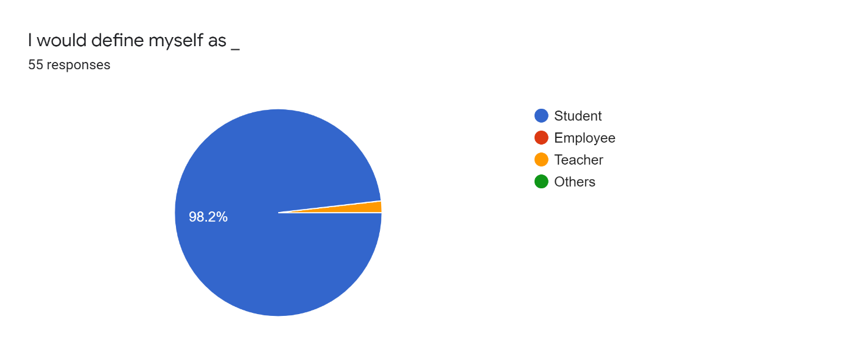
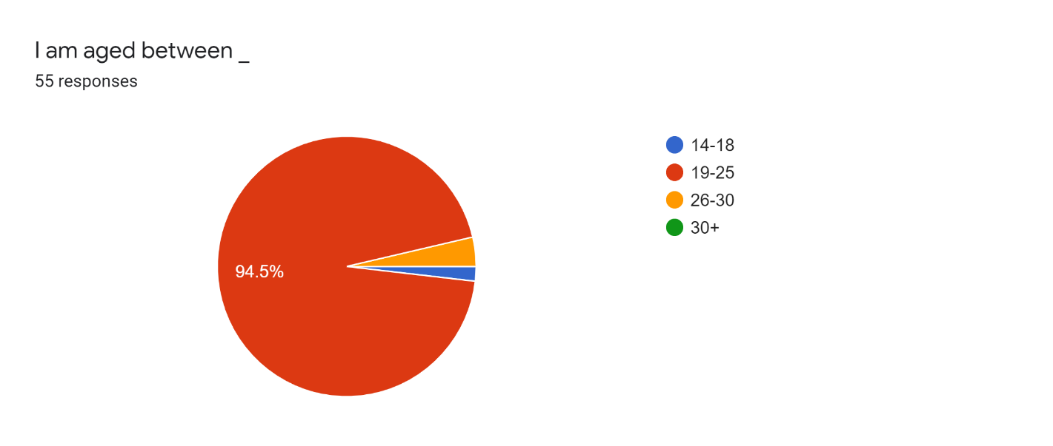
Participant's Occupation & Age
Most of them were Aged between 19 to 25 and most of them were Student

Slide 7
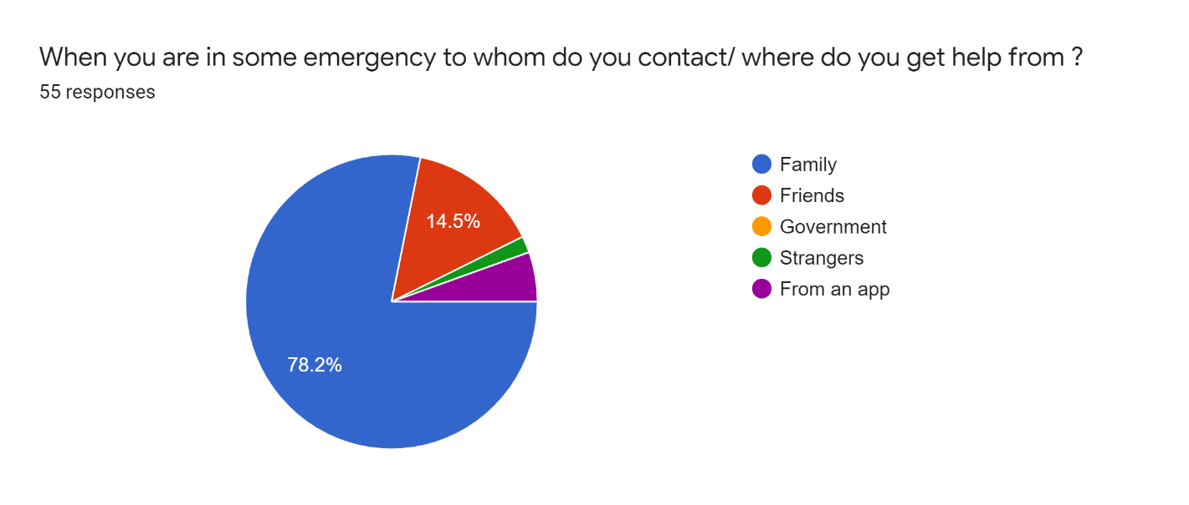
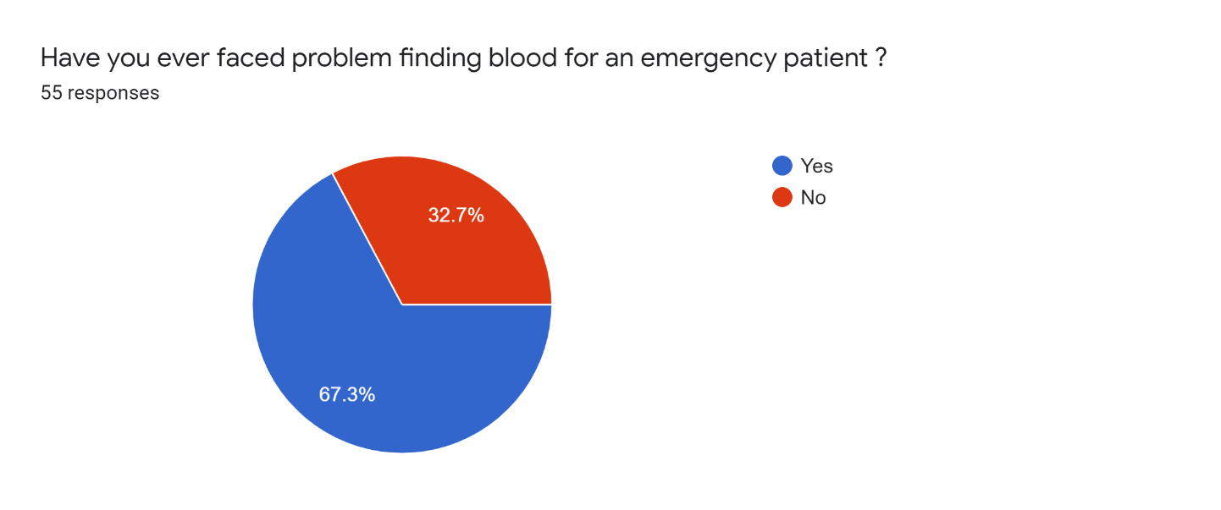
People tend to contact their family members during emergency
Around 70% people faced problem to find blood during crisis

Slide 8
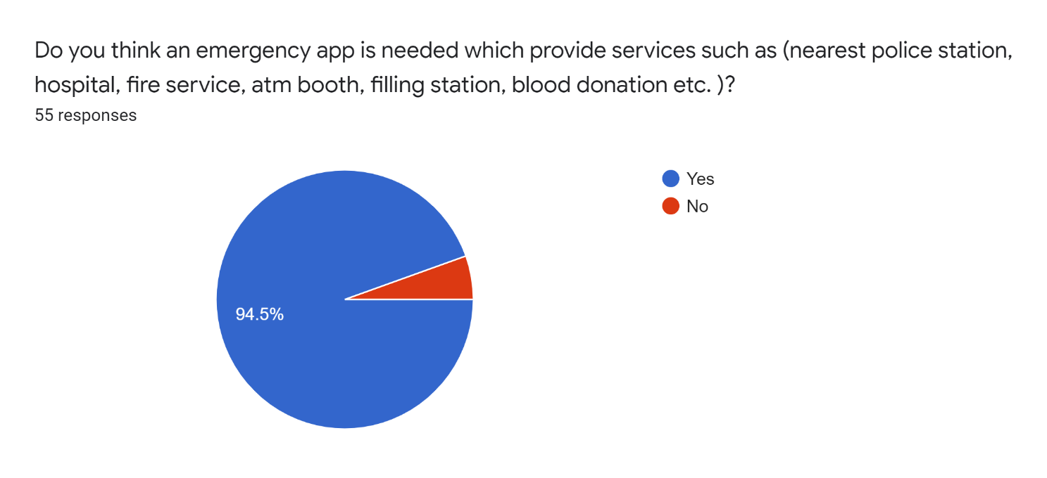
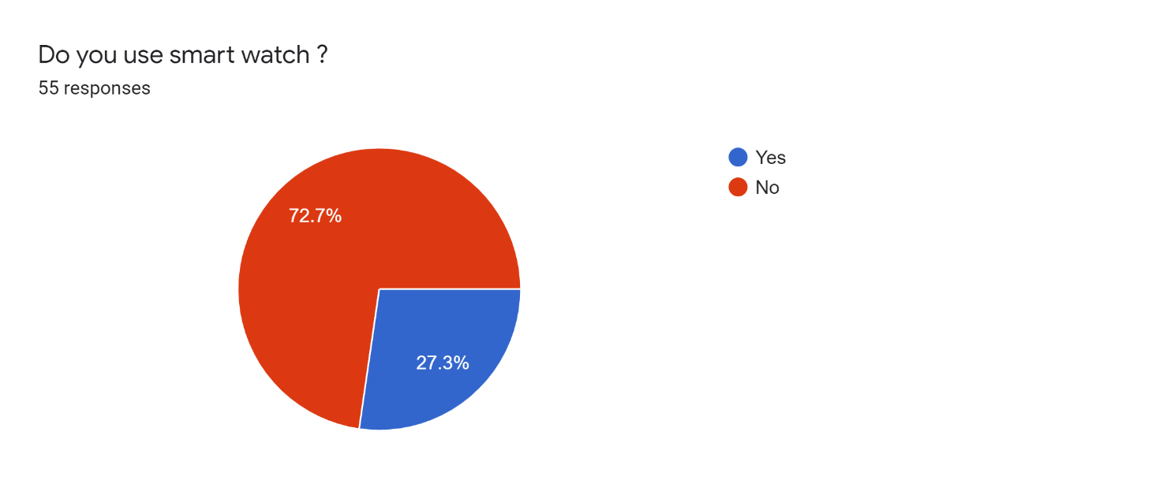
Almost everyone feels the need for such an App
Smart watch will help us to monitor heart rate and oxygen level during critical situation

Slide 9
Cost Benefit Analysis

Slide 10
Cost benefit Analysis
Costs | In 12 Months (BDT)
Upload In Play Store | 5000
Software Engineer | 100,000 (1 Month)
App Developer | 65,000
Advertisement | 40,000
Hidden Cost | 30,000
Maintenance Cost | 50,000
Total | 290,000

Slide 11
Gantt Chart

Slide 12
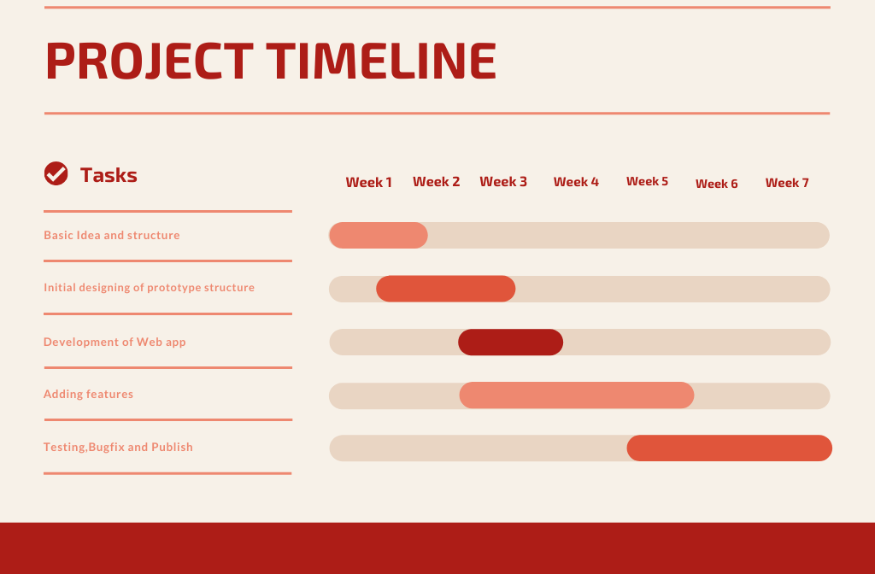
Weekly work schedule
We have around 5 tasks to complete within 7 weeks

Slide 13
Feasibility Study

Slide 14
Feasibility Study
Operational Feasibility : The data of users will remain secured throughout this application, the risk of data loss will be minimized.
Economical Feasibility : Developing this app needs low cost. So, the software is worth to develop considering the economical feasibility.
Year | Costs | Profit (BDT) | Net Profit (BDT)
1st Year | 290,000 | 180,000 | -110,000
2nd Year | 290,000 | 320,000 | 30,000
3rd Year | 290,000 | 470,000 | 180,000

Slide 15
Feasibility Study
3) Technical Feasibility : This app will be available to run on almost all android device higher than android version 6.O
4) Legal Feasibility : At this time, there are no potential legal or copyright difficulties with our project.

Slide 16
Conclusion
A Friend in
need is a
friend indeed
Together we will make the world a safer place

Slide 17


